Slide 1
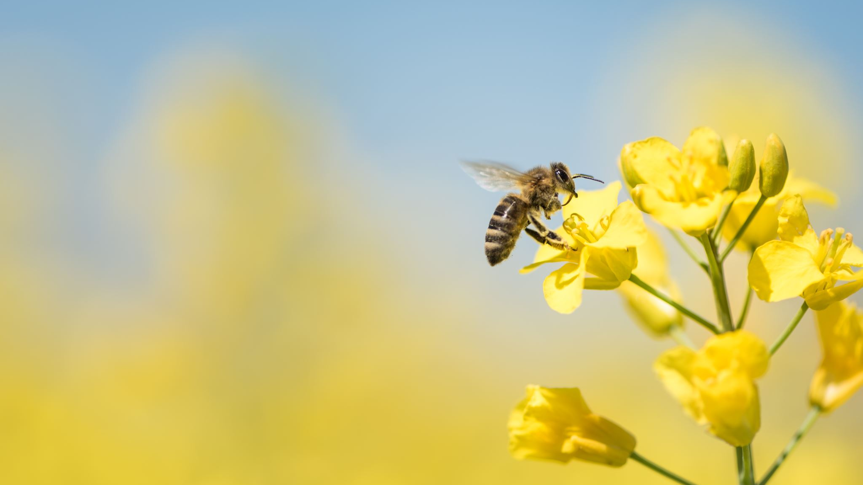
Florida bee shortage
Candidate Number-
Jack Murray

Slide 2
It's Un-bee-lievable!!!
Honeybee, 2021

Slide 3
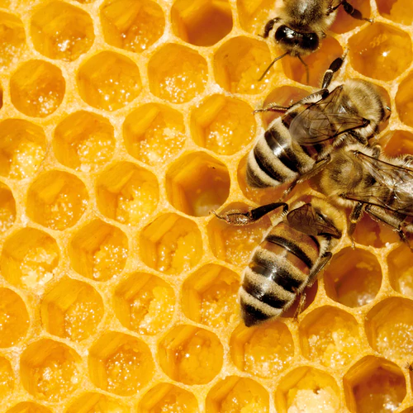
To what extent is Florida's Bee shortage a problem
Thesis
Bees and honey, 2021

Slide 4
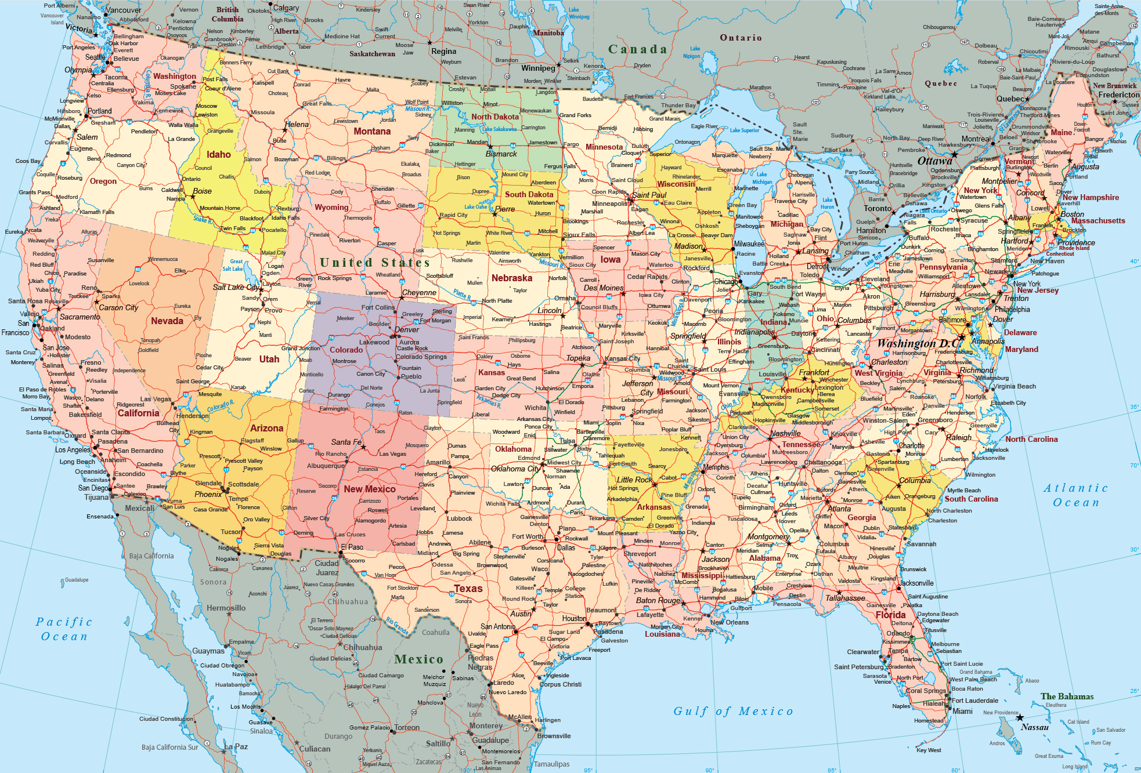
United states map, 2021
Florida

Slide 5
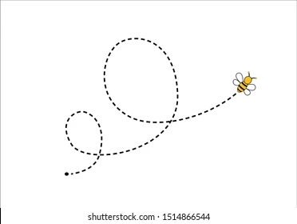
Group perspectives
Environmental
Economical
Political

Slide 6
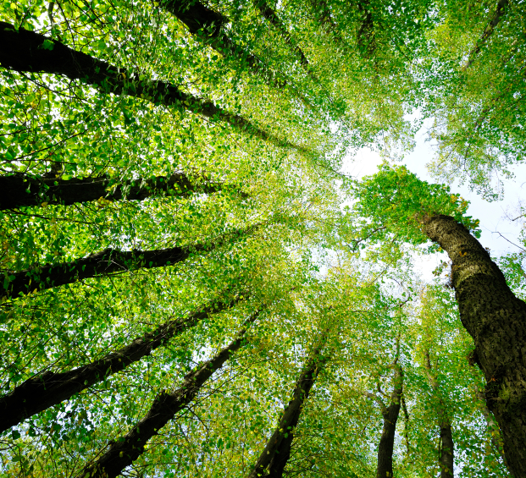
My Lense
Environmental
Thriving forest, 2021

Slide 7
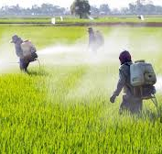
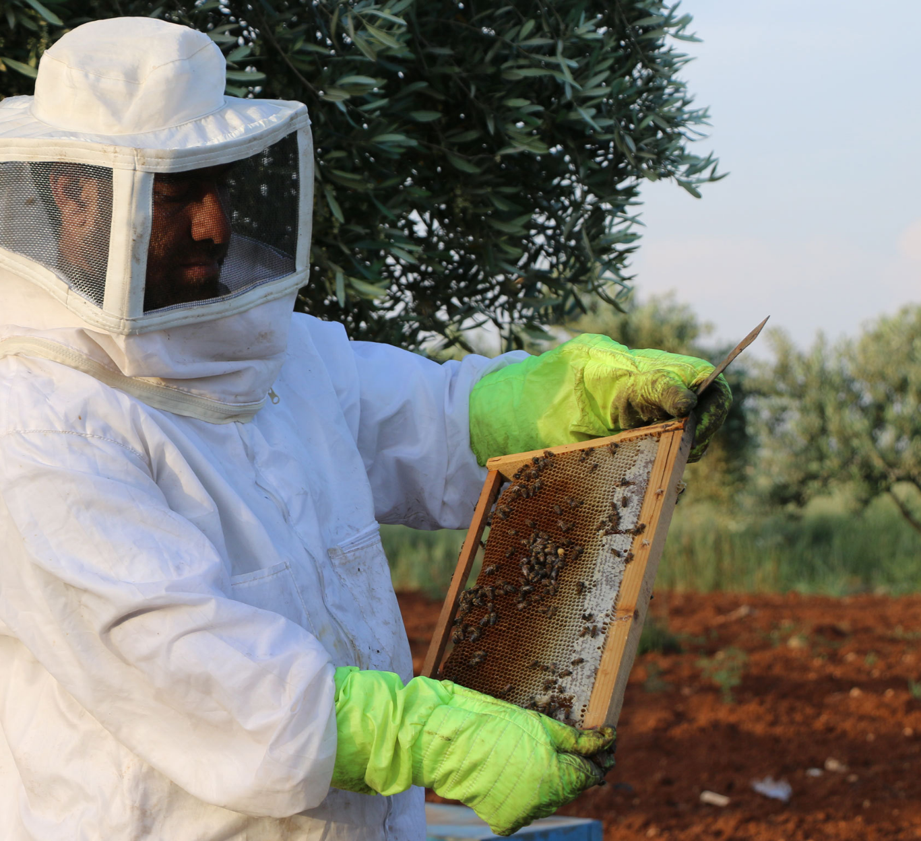
Reasons
Beekeeping Malpractice
Harmful Fertilizers
Harmful Fertilizers, 2021
Beekeeper, 2021

Slide 8
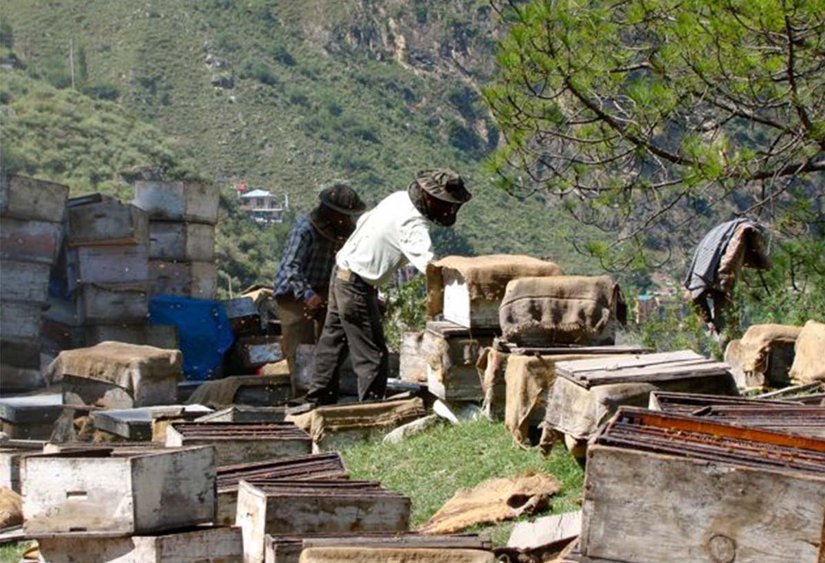
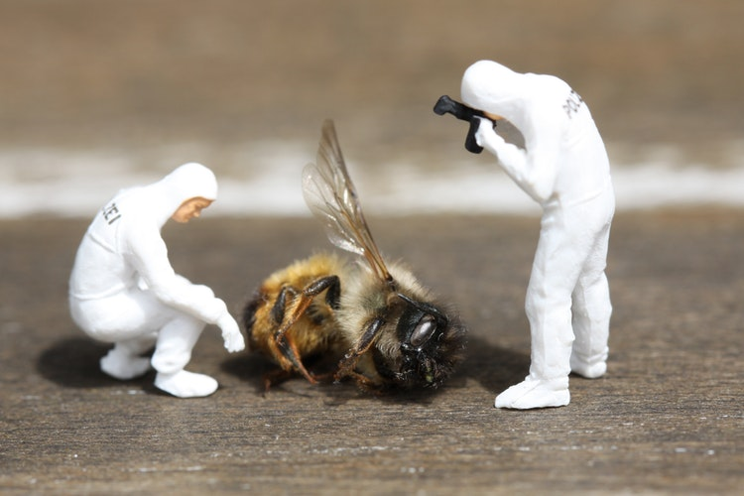
Beekeeping Negligence
India beekeeping malpractice, 2021
Harmful beekeepers, 2021
Dead bee, 2021

Slide 9
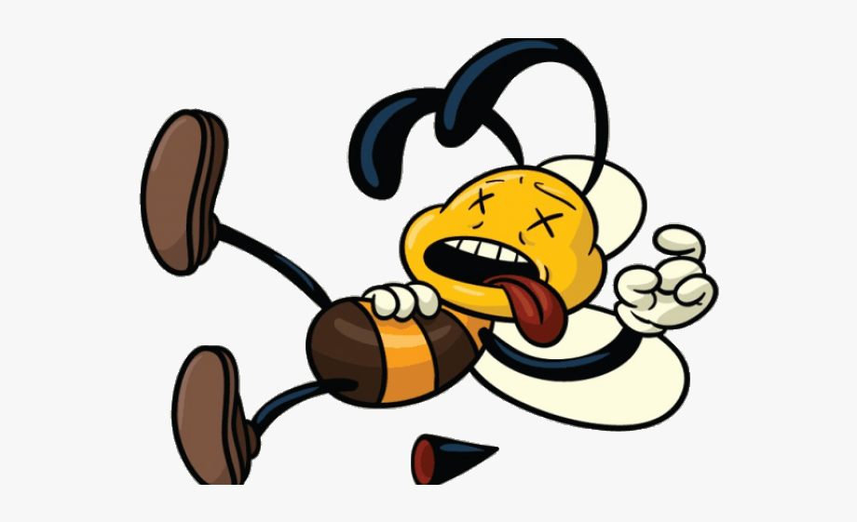
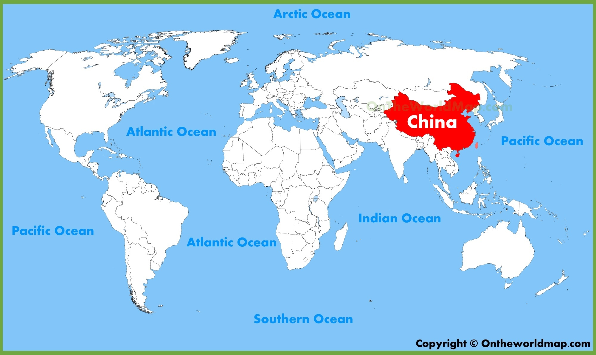
Deadly Fertilizers

Slide 10
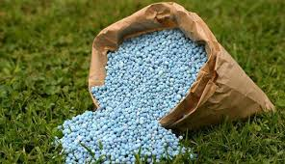
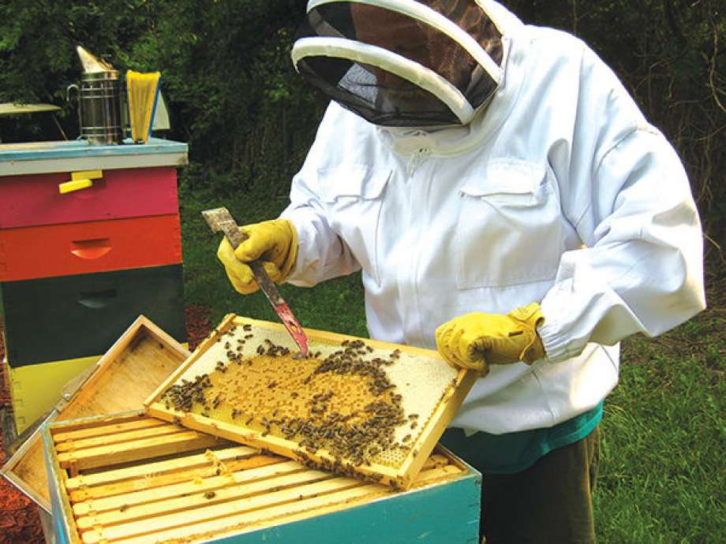
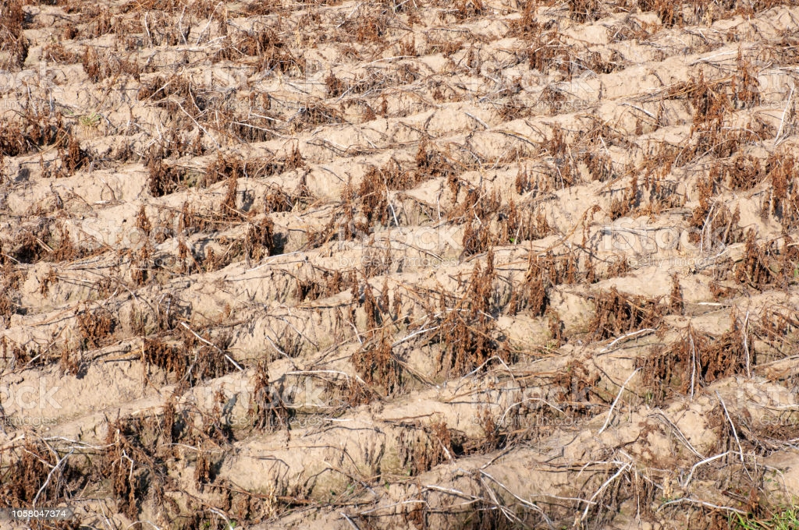
Recap
Fertilizers, 2021
Beekeeper taking honey, 2021
Dead bees, 2021

